Slide 1

Database Design and Implementation
Presentation By
GROUP 3
CEF440 - Internet & Mobile Programming
Instructor - Dr Valery Nkemeni
Academic Year: 2024/2025

Slide 2
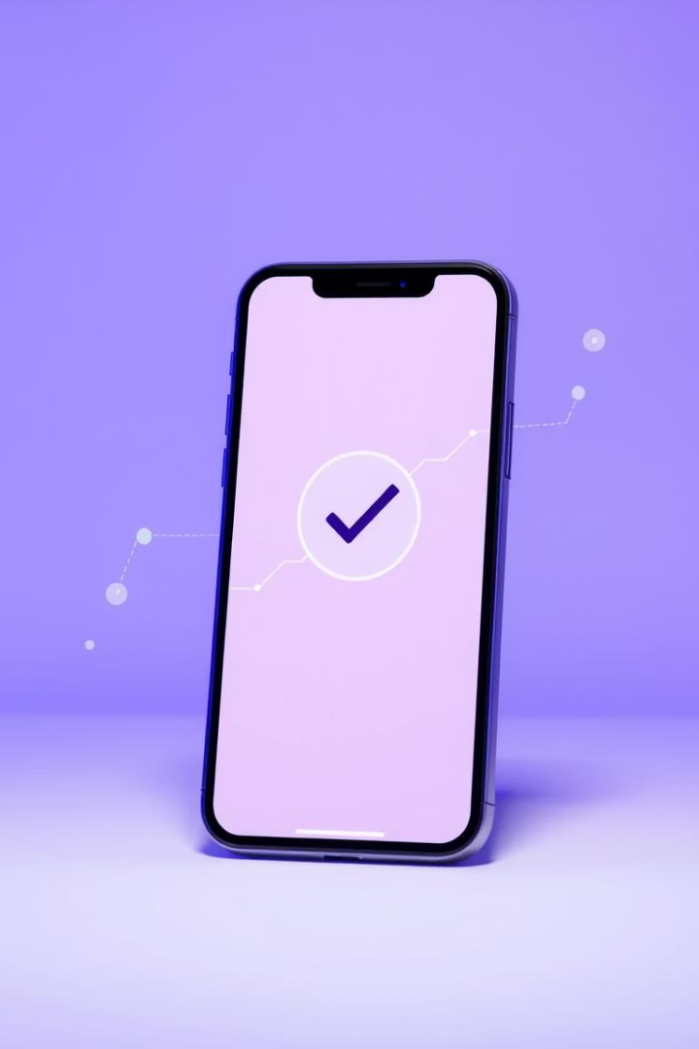
Introduction
This presentation outlines the data elements, conceptual design, and Entity-Relationship Diagram (ERD) for the "Checkin" mobile network monitoring application. We will also cover the database implementation using MongoDB and the backend API design.

Slide 3
Understanding Data Elements
Data elements are the fundamental units of data, each with a defined meaning and structure. They represent a single piece of information, such as a name, age, or phone number. Each element typically has a name, a data type (e.g., String, Integer), and specific constraints (e.g., unique, not null).
User Data
Network Metrics
Feedback Reports
user_id (PK): Unique identifier
metric_id (PK): Unique identifier
report_id (PK): Unique identifier
username: String (50 chars)
user_id (FK): References User
user_id (FK): References User
email: String (100 chars), validated
download_speed: Float (Mbps)
rating: Integer (1-5)
password_hash: String (hashed)
upload_speed: Float (Mbps)
comments: Text (nullable)
preferred_language: Enum ('en', 'fr')
latency: Integer (ms)
screenshot_url: String (nullable)
notification_preferences: Boolean
signal_strength: Integer (dBm)
location_latitude: Float (nullable)
data_sharing_preferences: Boolean
network_type: Enum ('2G', '3G', '4G', '5G', 'WiFi')
location_longitude: Float (nullable)
created_at: Timestamp
status: Enum ('Pending', 'In Progress', 'Resolved', 'Rejected')
last_login: Timestamp
carrier: String (50 chars)
location_latitude: Float (nullable)
created_at: Timestamp
location_longitude: Float (nullable)
updated_at: Timestamp
timestamp: Timestamp
operator_notes: Text (nullable)

Slide 4
Additional Data Elements
Beyond user and core network data, the "Checkin" app incorporates elements for alerts, operator information, and regulatory reports. These ensure comprehensive monitoring, communication, and compliance within the network ecosystem.
Alerts
Operator
Regulatory Reports
alert_id (PK): Unique identifier
operator_id (PK): Unique identifier
report_id (PK): Unique identifier
user_id (FK): References User
name: String (100 chars)
period_start: Date
alert_type: Enum ('Low Signal', 'High Latency', 'Slow Speed', 'Outage', 'Maintenance')
contact_email: String (100 chars)
period_end: Date
service_area: String (100 chars)
average_download_speed: Float
is_active: Boolean (default true)
average_upload_speed: Float
message: String (255 chars)
average_latency: Float
severity: Enum ('Low', 'Medium', 'High', 'Critical')
outage_count: Integer
complaint_count: Integer
is_read: Boolean (default false)
generated_at: Timestamp
created_at: Timestamp
operator_id (FK): References Operator (nullable for aggregate reports)
dismissed_at: Timestamp (nullable)

Slide 5
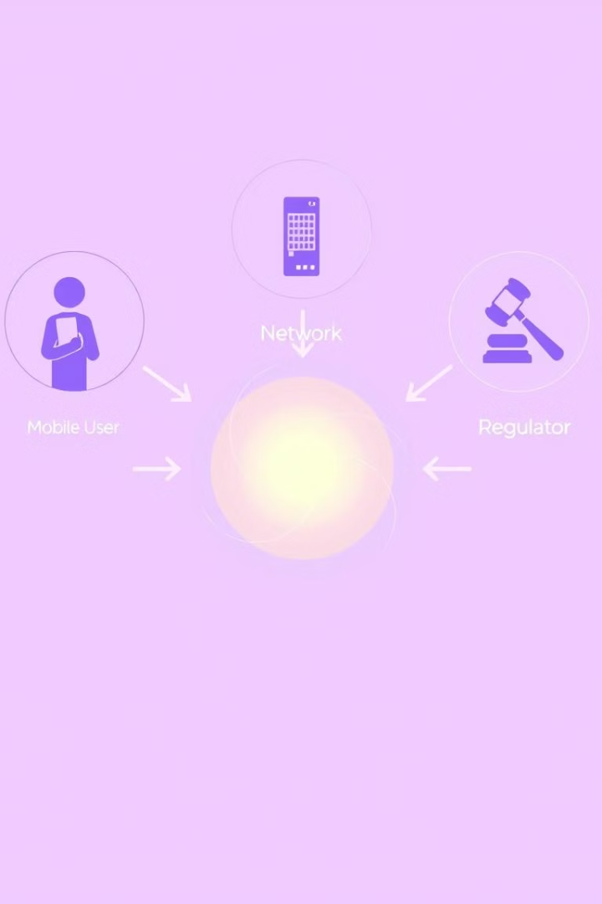



Conceptual Design Overview
Conceptual design defines the data structure and meaning without focusing on physical implementation. It uses Entity-Relationship (ER) diagrams to represent business requirements. The "Checkin" application features a user-centric design with three main roles: Mobile Subscribers, Network Operators, and Regulatory Authorities.
Mobile Subscribers
Network Operators
Primary users monitoring network quality and submitting feedback.
Secondary users receiving aggregated reports and individual feedback.
Regulatory Authorities
Tertiary users receiving anonymized aggregate data for compliance.

Slide 6





Key Conceptual Components & ERD
The "Checkin" app's conceptual design includes continuous network monitoring, a user feedback system, an alert system, comprehensive reporting, and settings management. These components are interconnected, as illustrated in the Entity-Relationship Diagram (ERD), which defines relationships between entities like User, NetworkMetrics, and FeedbackReports.
Network Monitoring
Continuous background collection of network metrics.
Feedback System
User-submitted reports with optional location data.
Alert System
Notifications about network conditions or feedback responses.
Reporting
Historical views of metrics and feedback for all user types.
Settings Management
User preferences for privacy, notifications, and language.

Slide 7
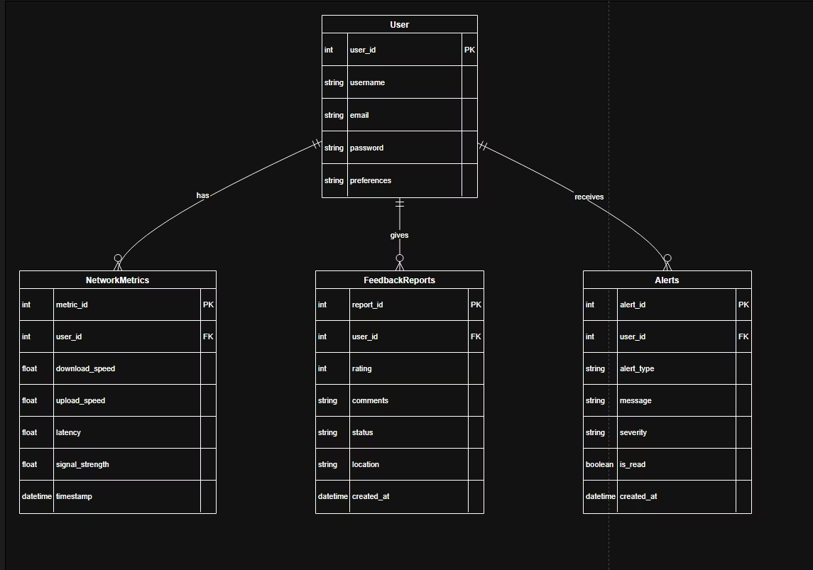
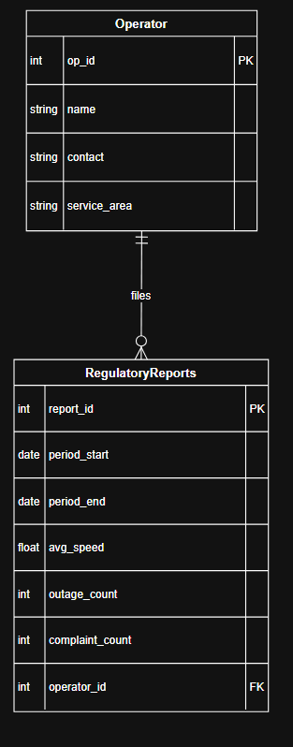
Entity Relation Diagram

Slide 8
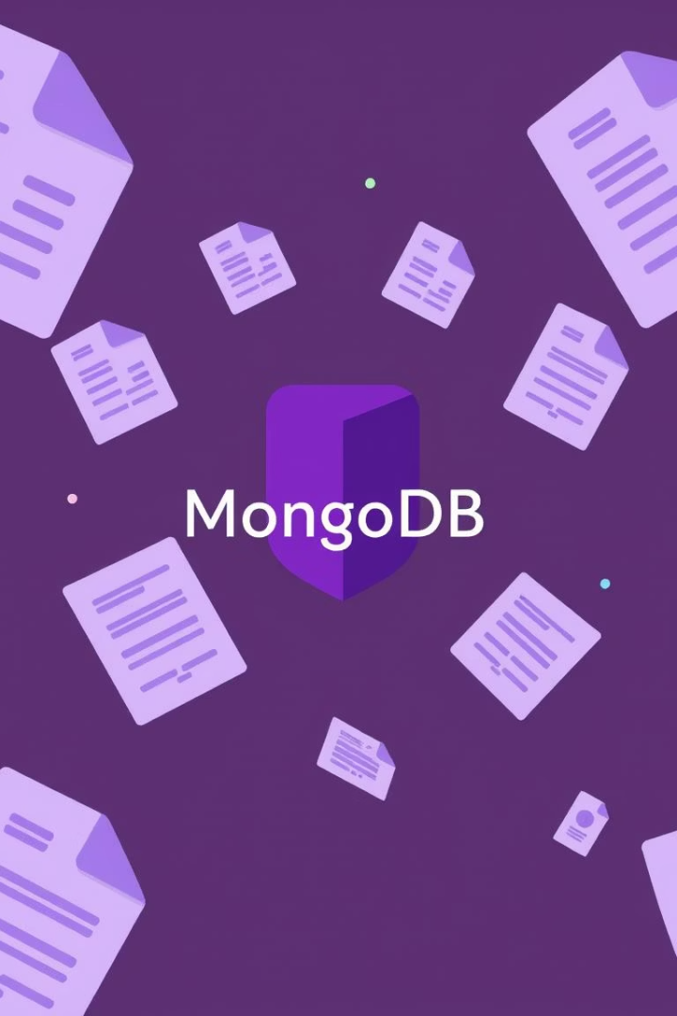




Database Implementation: MongoDB
For the "Network Alerts & Diagnostics" project, MongoDB was chosen as the primary database. This NoSQL, document-oriented database offers schema flexibility, easy scalability, and seamless integration with JSON-like data, which aligns perfectly with our backend's Node.js and Express framework.
Schema Flexibility
Scalability
JSON-Like Storage
Accommodates diverse data structures without complex migrations.
Supports horizontal scaling and high availability for data growth.
Enables seamless mapping with frontend and backend JSON communication.
Rapid Development
Integrates easily with Node.js using Mongoose ODM for fast cycles.

Slide 9
Backend API Design and Endpoints
The backend, built with Node.js and Express, exposes several API endpoints for data submission and retrieval. These include health checks, feedback, speed test results, and network trend data, ensuring robust communication between the mobile app and the database.
Health Check
1
GET /api/health: Verifies server status and connectivity.
2
Feedback
POST /api/feedback: Receives and saves user feedback. GET /api/feedback: Retrieves latest 20 submissions.
Speed Test
3
POST /api/speedtest: Stores speed test results. GET /api/speedtest: Fetches latest 20 results. GET /api/speedtest/history/:userId: Retrieves user-specific history.
4
Network Trend
POST /api/network-trend: Logs network status datapoints. GET /api/network-trend: Retrieves recent samples.
Combined Diagnostics
5
POST /api/diagnostics: Accepts combined feedback, speed test, and network trend data.

Slide 10
Connecting Database to Backend
Connecting the MongoDB database to the Node.js backend involves installing Mongoose and dotenv, configuring environment variables for security, and using Mongoose to establish the connection. This setup enables the backend to define models and perform CRUD operations, ensuring seamless data interaction.
Install Packages
Install Mongoose and dotenv for database interaction and secure configuration.
Configure Environment Variables
Set MONGODB_URI and PORT in a .env or url.env file.
Load Environment Variables
Use dotenv.config() at the top of your server.js to load variables.
Connect to MongoDB
Use mongoose.connect(MONGODB_URI) before starting the Express server.
Define Mongoose Models
Create schemas and models for each data type (e.g., Feedback, SpeedTest).
Use Models in API Endpoints
Implement CRUD operations within Express routes using the defined models.

Slide 11
Conclusion
The implementation of the backend and database was done successffuly
ER Diagrams ensure clarity of relationships
Hence a fully functional app that successfully addresses user needs

